Slide 1
2021 United Coaching Development

Slide 2
Two club initiatives to be implemented across all teams and coaches
1. System of Training Efficiency
2. Use of analytics to better evaluate performance & guide training

Slide 3
System of Training Efficiency
“Efficiency”--?
Training + Efficiency= designing all aspects of your training to get the most out of each session
More player development
More progress by players and teams
Faster progress
Can be utilized no matter:
What you are working on
Your coaching style

Slide 4
Typical scenario
Team trains 3 times a week for 90 minutes = 270 minutes of training
How get the very most out of each session?
Starts with a different question
How do we know what we should be focusing on in training?

Slide 5
Cycle of training efficiency
The Match
Use match to evaluate play and determine focus of training
The ONE thing, the MOST important thing
It is pointless and inefficient to try to use training to correct multiple issues
Design training sessions to address/correct
Match as test
Have we fixed the problem?
Reevaluate
Beginning of season? Use team scrimmage

Slide 6
Cycle of Training Efficiency
MATCH EVALUATION
TRAINING
Constantly evaluating and tailoring training to address relevant problems of team
Determining if training has successfully addressed
U14 & above-discuss with players—

Slide 7
The Training Session
Basics
Come early to set up
Start on time
Expectation….
Have clear times when break and how long
Ex. 2-minute break at 30 minutes

Slide 8
The Training Session
Every activity addresses issue from match to be worked on
Exception—technical warm-up
Each activity easy flow to next
Don’t complicate things and spend time setting and resetting field

Slide 9
Example

Slide 10
Example

Slide 11
example

Slide 12
Training efficiency
Use activities that have a focus BUT also works more than one skill, tactic, etc.
Dynamic activities that help conditioning
=greater efficiency

Slide 13
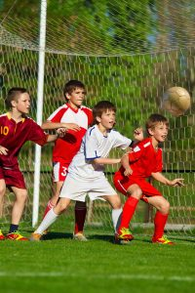
Training efficiency
No lectures—ever!
They are not listening
They are not learning
They are not training
Even instructions for training activity…quick
If teachable moment, ask they to problem solve
Don’t tell them what to do
Adds layer of learning

Slide 14
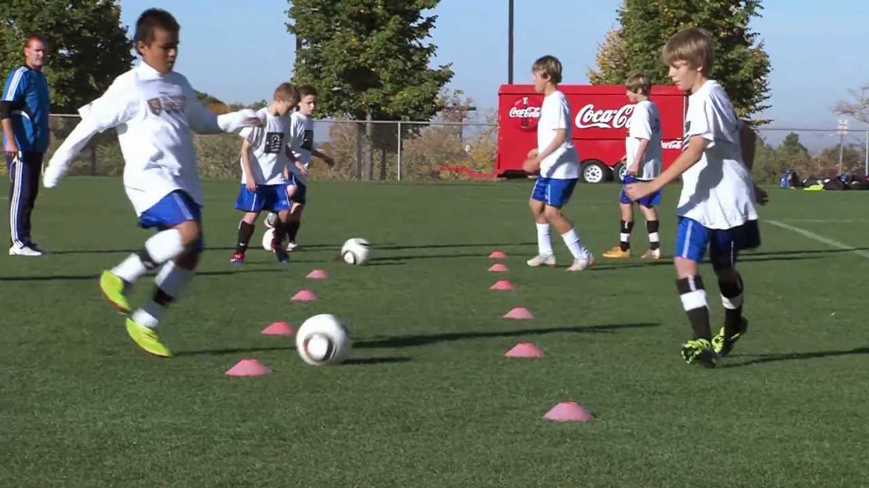
Activities should be match relevant and related
Example—we need to work on passing

Slide 16
Training efficiency
No Lines!
Inefficient—only one/two players training
Waste of precious time
Non-match related
Boring
Players lose interest
https://columbusunitedsoccer.com/video-resources/

Slide 17
Further Tips for Efficiency
Don’t stop an entire group to correct one player
Inefficient
Other players resentful, One player isolated
Others aren’t training
Call player over correct, send back in

Slide 18
Stop entire group when entire group needs to be addressed
“Freeze”—please no
Natural stoppage
Don’t ask players to recreate where they were—they don’t know
Coach quickly resets the field
If tactical—ask players to problem solve

Slide 19
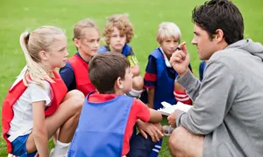
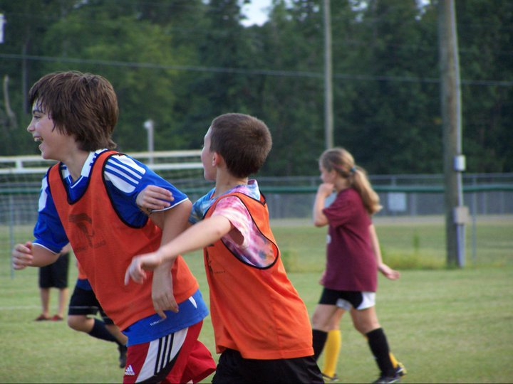
Ending the session
End EVERY training session with “the game”
Why?
They want TO PLAY
Emphasize training focus to game situation
Gives coach mini-evaluation session

Slide 20
Efficiency in match warm-up
What’s In a Warm-up?

